Slide 1
Specific resistance to infection

Slide 2
Pathogens
Micro-organism or agent that cause disease.
Pathogens must first enter the body and evade the non-specific defences such as skin, mucous, and patrolling phagocytes and granulocytes.
Lymphocytes are made in bone marrow and found in lymph nodes. Macrophages (phagocytic cells) are types of white blood cells important to both specific and non-specific immune response.

Slide 3
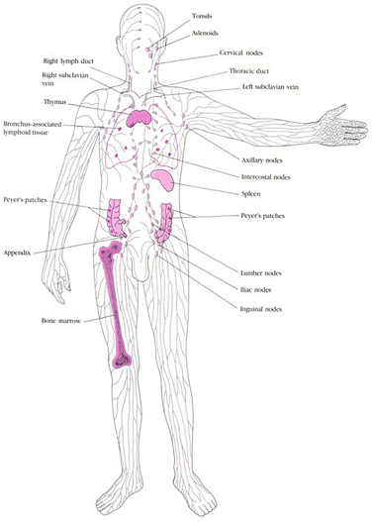
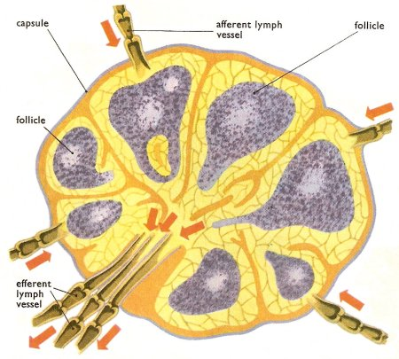
Lymphoid tissue
Lymph node

Slide 4
Two types of immunity
Antibody mediated immunity (humoral response) – provided by the B cells. Involves the manufacture of antibodies.
Cell-mediated immunity – provided by the T cells. Involves the formation of specialised cells that destroy pathogens.
Lymphocytes are made in the bone marrow, T cells mature in the Thymus and B-cells mature in the Bone marrow.

Slide 5
Antigens
Any substance that causes an immune response.
In immunology, an antigen (Ag) is a molecule or molecular structure, such as may be present on the outside of a pathogen, that can be bound by an antigen-specific antibody or B-cell antigen receptor.^{[1]} The presence of antigens in the body normally triggers an immune response.^{[2]} https://en.wikipedia.org/wiki/Antigen
Causes the body to produce antibodies.
E.g. Virus, bacterial cell, part of a bacterial cell, bacterial toxins, transplanted tissues, foreign blood cells, pollen.
The immune system is programmed to differentiate between self-antigens and non-self-antigens.

Slide 6
Antibodies
A specialised protein that is produced in response to a non-self-antigen.
It binds with the antigen to form an antigen-antibody complex.
Antibodies belong to the group of proteins known as immunoglobulins (Ig).
Each antibody will bind to only one antigen – like a lock and key

Slide 7
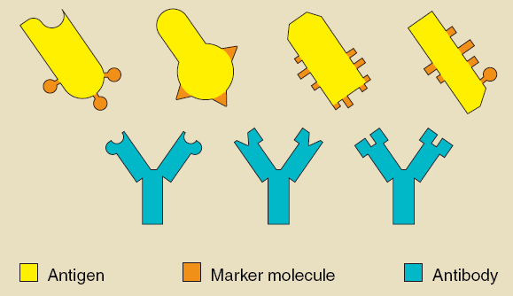
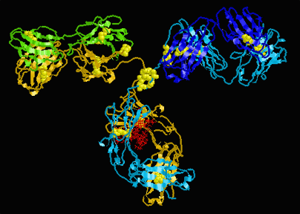
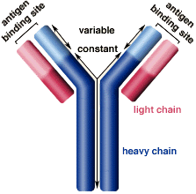
Lock and
Key model
Antibody
structure

Slide 8
Antibody-mediated immunity
(humoral response)
Resistance against viruses, bacteria, and bacterial toxins
B-cells detect the presence of an antigen, activating a B-cell. It enlarges and divides into a group of cells (clone)
Most of these cells become plasma cells and secrete the antigen specific antibody.
Those left remain as memory cells and spread to all body tissues to allow for a faster response next time.

Slide 9
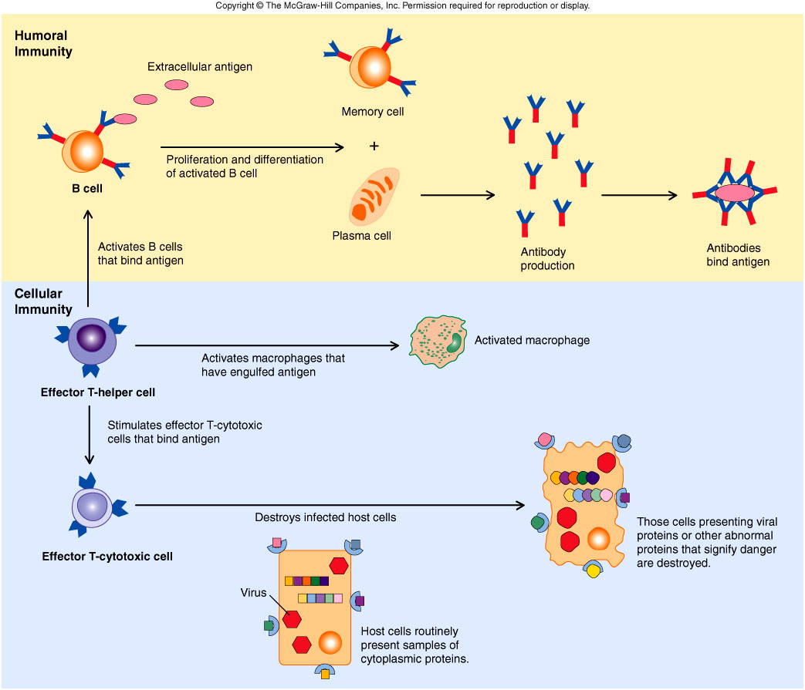
Antibody-mediated immunity
(humoral response)
Most B-cells in the clone become plasma cells

Slide 10
Antibody-mediated immunity
(humoral response)

Slide 11
Primary and secondary response
Primary response: body’s immune system responds slowly taking several days to build up large amounts of antibodies. The primary response leaves the body with a ‘memory’ of that particular antigen.
Secondary response: due to the activity of the memory cells the production of antibodies happens quicker and produces a lot more antibodies.

Slide 12
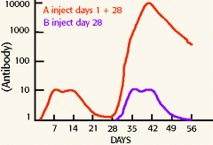
Primary and secondary response
The memory B-cells allow the body to mount a secondary response when exposed to an antigen for the second time.
Often this results in experiencing no illness on second exposure

Slide 13
Summarise antibody-mediated response
Write a summary of the antibody-mediated response to a pathogen.

Slide 14
Removing the antigen
Macrophages engulf the antibody-antigen complex by phagocytosis.
To help this antibodies often cause:
    Combine to inhibit reaction with cells
    Bind to antigen to prevent entry into cells
    Agglutinate so can be digested/cannot enter a cell
    Dissolve antigen
    Turn a soluble antigen into an insoluble antigen
    Bind to virus surface preventing entry into cells

Slide 15
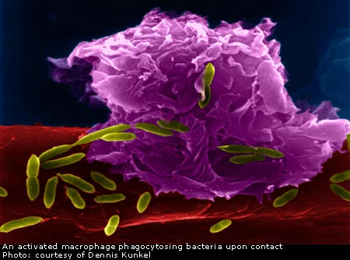
Macrophage phagocytising bacteria

Slide 16
Cell mediated immunity
Provides immunity against resistance to the intracellular phase of bacterial and viral infections. These pathogens invade the host cells and use the host cells to replicate.
Plays a role in rejecting transplants, fighting cancer and responding to fungal infections and parasites

Slide 17
T-cells
Like B-cells are responsive to only one antigen.
A B-cell or macrophage travels to a lymph node and presents an antigen to a T-cell.
This sensitises or activates the T-cell.
The sensitised T-cells enlarge and divide giving rise to a clone.
As with B-cells a small number of cells remain as memory T-cells.

Slide 18
T-cells
The plasma T-cells differentiate into:
  Killer T-cells: find the source of infection, attach to the antigen and secrete a substance that kills the cell.
  Helper T-cells: cause lymphocytes near the infection to become sensitised, increasing the number of antibodies produced. They also attract macrophages to the source of infection and increase their activity
  Suppressor T-cells: Inhibit T and B cell activity slowing the immune response once the infection has been dealt with.

Slide 20
Summarise the differences between B and T cells
Factor | B-cells | T-cells
Mature in… | Bone marrow | Thymus
Found mainly in… | Lymphatic tissue | Body tissues
Clone to form… | Plasma cells | Killer T-cells
Destroy antigens by… | Antibody production | Direct attack
Primarily active against… | Bacteria and extracellular antigens | Viruses and intracellular antigens

